Slide 1
COMP0005 – ALGORITHMS 1.2 Analysis of Algorithms
Prof Licia Capra
Dept of Computer Science

Slide 2
CONTENT
Steps to developing algorithms
Analysis of algorithms
Observations
Mathematical Models
Order of growth classifications
Abstract Data Types (ADTs)

Slide 3
ANALYSIS - OBSERVATIONS
Example - Bubblesort

Slide 4
ANALYSIS - OBSERVATIONS
Example - Bubblesort
N | Time (seconds)
100 | 0.0010
500 | 0.0241
1,000 | 0.1079
5,000 | 2.4596
10,000 | 9.9533
15,000 | 23.2191
20,000 | 42.6870
running time T(N)
problem size N

Slide 5
ANALYSIS - OBSERVATIONS
System independent factors
Algorithm
Input data
System dependent factors
Hardware (CPU, memory, cache,…)
Software (programming language, compiler, …)
System (operating system, other running apps, …)

Slide 6
ANALYSIS – MATH MODELS
Total running time: sum of cost x frequency of all operations
Cost of operation depends on machine and compiler
Frequency depends on algorithm and input data

Slide 7
ANALYSIS – MATH MODELS
Example - Cost
Basic Operation | Example | Nanoseconds
Integer add | a+b | 2.1
Integer multiply | a*b | 2.4
Integer divide | a/b | 5.4
Floating-point add | a+b | 4.2
Floating-point multiply | a*b | 4.6
Floating-point divide | a/b | 13.5
Sine | math.sin(a) | 91.3
… | … | …
Basic Operation | Example | Nanoseconds
Var declaration | a | c0
Assignment stmt | a=b | c1
Integer comparison | a<b | c2
Array access | a[i] | c3
1D array allocation | int[N] | c4*N
2D array allocation | int[N][N] | c5*N²
String concat | s+t | c6*N
… | … | …

Slide 8
ANALYSIS – MATH MODELS
Example – Frequency
Question: how many instructions as a function of input size N?
Operation | Frequency
Var declaration | 2
Assignment stmt | 2
Less-than compare | N+1
Equal-to compare | N
Array access | N
Increment | N to 2*N
count=0
for i in range(N):
if a[i]==0:
count+=1
int count=0;
for (int i=0; i<N; i++)
if (a[i]==0)
count=count+1

Slide 9
ANALYSIS – MATH MODELS
Example – Frequency
Question: how many instructions as a function of input size N?
count=0
for i in range(0,N):
for j in range(i+1,N):
if a[i]+a[j]==0:
count=count+1
Operation | Frequency
Var declaration | 2+N
Assignment stmt | 2+N
Less-than compare | ?
Equal-to compare | ?
Array access | N(N-1)
Increment | ?
2*(number of times I execute inner loop)
i=0→N-1
i=1→N-2
…
i=N→0
2* ((N-1)+(N-2)+..+0)=N(N-1)

Slide 10
ANALYSIS – MATH MODELS
Example – All operations
Question: how many instructions as a function of input size N?
count=0
for i in range(0,N):
for j in range(i+1,N):
if a[i]+a[j]==0:
count=count+1
Operation | Frequency
Var declaration | 2+N
Assignment stmt | 2+N
Less-than compare | ½ (N+1)(N+2)
Equal-to compare | ½ N(N-1)
Array access | N(N-1)
Increment | ½ N(N-1) to N(N-1)

Slide 11
ANALYSIS – MATH MODELS
Example – simplifications
# 1 – focus on most costly & most frequently executed operations
# 2 – ignore lower order terms (tilde ~ notation)
→ Express running time as function of input size N

Slide 12
ANALYSIS – MATH MODELS
Example – simplifications
Tilde notation
count=0
for i in range(0,N):
for j in range(i+1,N):
if a[i]+a[j]==0:
count=count+1
Operation | Frequency | Tilde
Var declaration | 2+N | ~N
Assignment stmt | 2+N | ~N
Less-than compare | ½ (N+1)(N+2) | ~½ N²
Equal-to compare | ½ N(N-1) | ~½ N²
Array access | N(N-1) | N²
Increment | ½ N(N-1) to N(N-1) | ~½ N² to ~N²

Slide 13
ANALYSIS – MATH MODELS
Example – simplifications
Focus on highest (cost*freq) operations
Prev Q: how many instructions as a function of input size N?
Prev A: (2+N)+(2+N)+½(N+1)(N+2)+½N(N-1)+N(N-1)+N(N-1)
New Q: approximately how many array accesses as a function of input size N?
New A: ~N² array accesses
count=0
for i in range(0,N):
for j in range(i+1,N):
if a[i]+a[j]==0:
count=count+1

Slide 14

ANALYSIS – MATH MODELS
Example
Q: approximately how many array accesses as a function of input size N?
A: ~ ½ N³ array accesses
count=0
for i in range(0,N):
for j in range(i+1,N):
for k in range(j+1,N):
if a[i]+a[j]+a[k]==0:
count=count+1
3 * $\frac{N\left(N−1\right)\left(N−2\right)}{3!}$

Slide 15
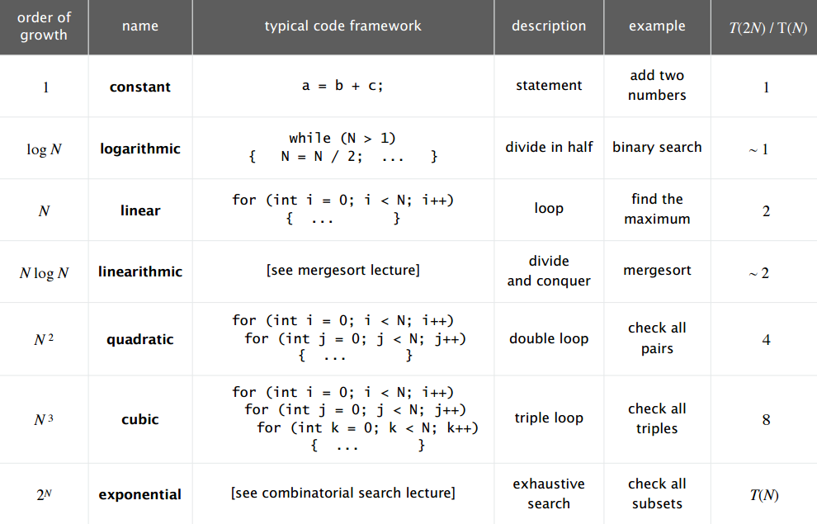
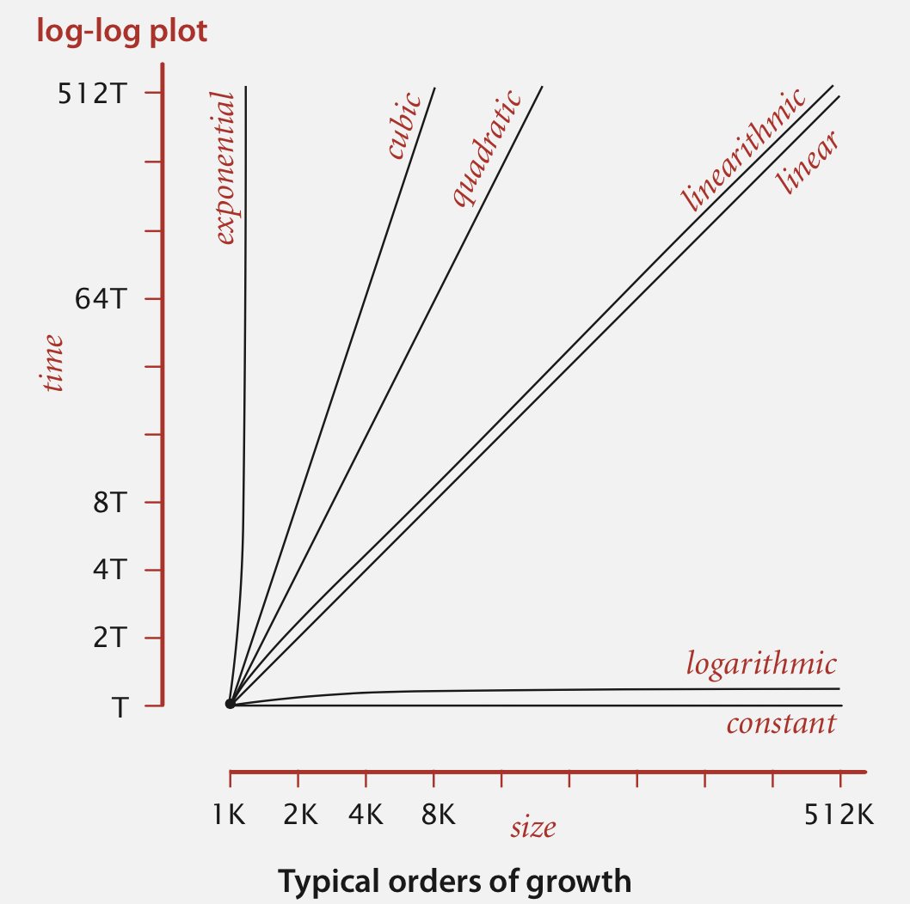
ANALYSIS – ORDER OF GROWTH
Order of growth of algorithms

Slide 16
ANALYSIS – ORDER OF GROWTH
Order of growth of algorithms

Slide 17
ANALYSIS – ORDER OF GROWTH
Example: binary search
Given a sorted array of integers, determine if an item is present
0 | 1 | 2 | 3 | 4 | 5 | 6 | 7 | 8 | 9 | 10
6 | 23 | 39 | 45 | 52 | 69 | 71 | 79 | 80 | 88 | 94
x=44
x==a[5]
x==a[2]
x==a[3]

Slide 18
ANALYSIS – ORDER OF GROWTH
Example: binary search
Given a sorted array of integers, determine if an item is present
0 | 1 | 2 | 3 | 4 | 5 | 6 | 7 | 8 | 9 | 10
6 | 23 | 39 | 45 | 52 | 69 | 71 | 79 | 80 | 88 | 94
x=88
x==a[5]
x==a[8]
x==a[9]

Slide 19
QUICK DIGRESSION …

Slide 20
WHAT IS PSEUDOCODE
Pseudocode
It is not natural language (e.g., English)
We need to maximize clarity
We need to minimize ambiguity
It is not code
We need machine independence
We need programming language independence
We need a higher level view

Slide 21
WHAT IS PSEUDOCODE
Pseudocode
There is no standard form of pseudocode. Common conventions:
Use familiar notation (language keywords from Python, C, Java, etc.):
Statements: declarations, assignments, conditional statements (if-else), loops (while, for), function definitions and function calls, return statement, …
Types: int, double, bool, char, string, address, array, …
Expressions: arithmetic, comparisons, …
Avoid unnecessary details (e.g., imports) or complexity
We can use bits of English and maths

Slide 22
… BACK TO ANALYSIS

Slide 23
ANALYSIS – ORDER OF GROWTH
Example: binary search
Pseudocode
0 | 1 | 2 | 3 | 4 | 5 | 6 | 7 | 8 | 9 | 10
low=0
high=len(a)
while (low <= high)
mid = low + (high - low)/2
if x < a[mid] high=mid-1
else if x > a[mid] low=mid+1
else return mid
return -1
a[]
low
mid
high

Slide 24
ANALYSIS – ORDER OF GROWTH
Example: binary search
Pseudocode
x=44
0 | 1 | 2 | 3 | 4 | 5 | 6 | 7 | 8 | 9 | 10
6 | 23 | 39 | 45 | 52 | 69 | 71 | 79 | 80 | 88 | 94
low=0
high=len(a)
while (low <= high)
mid = low + (high - low)/2
if x < a[mid] high=mid-1
else if x > a[mid] low=mid+1
else return mid
return -1
a[]
low
mid
high
low=0, high=10
mid=5, x<a[5]→ high=4

Slide 25
ANALYSIS – ORDER OF GROWTH
Example: binary search
Pseudocode
x=44
0 | 1 | 2 | 3 | 4 | 5 | 6 | 7 | 8 | 9 | 10
6 | 23 | 39 | 45 | 52 | 69 | 71 | 79 | 80 | 88 | 94
low=0
high=len(a)
while (low <= high)
mid = low + (high - low)/2
if x < a[mid] high=mid-1
else if x > a[mid] low=mid+1
else return mid
return -1
a[]
low
mid
high
low=0, high=10
mid=5, x<a[5]→ high=4
low=0, high=4
mid=2, x>a[2]→ low=3

Slide 26
ANALYSIS – ORDER OF GROWTH
Example: binary search
Pseudocode
x=44
0 | 1 | 2 | 3 | 4 | 5 | 6 | 7 | 8 | 9 | 10
6 | 23 | 39 | 45 | 52 | 69 | 71 | 79 | 80 | 88 | 94
low=0
high=len(a)
while (low <= high)
mid = low + (high - low)/2
if x < a[mid] high=mid-1
else if x > a[mid] low=mid+1
else return mid
return -1
a[]
low
mid
high
low=0, high=10
mid=5, x<a[5]→ high=4
low=0, high=4
mid=2, x>a[2]→ low=3
low=3, high=3
mid=3, x<a[3]→ high=2

Slide 27
ANALYSIS – ORDER OF GROWTH
Example: binary search
Pseudocode
x=44
0 | 1 | 2 | 3 | 4 | 5 | 6 | 7 | 8 | 9 | 10
6 | 23 | 39 | 45 | 52 | 69 | 71 | 79 | 80 | 88 | 94
low=0
high=len(a)
while (low <= high)
mid = low + (high - low)/2
if x < a[mid] high=mid-1
else if x > a[mid] low=mid+1
else return mid
return -1
a[]
low
mid
high
low=0, high=10
mid=5, x<a[5]→ high=4
low=0, high=4
mid=2, x>a[2]→ low=3
low=3, high=3
mid=3, x<a[3]→ high=2
low=3, high=2

Slide 28
ANALYSIS – ORDER OF GROWTH
Example: binary search
Pseudocode
T(N) = number of compares that binary search needs to execute as a function of array size N
T(N) ~ ln(N)
low=0
high=len(a)
while (low <= high)
mid = low + (high - low)/2
if x < a[mid] high=mid-1
else if x > a[mid] low=mid+1
else return mid
return -1
Approximation

Slide 29
ANALYSIS – ORDER OF GROWTH
Types of Analyses
Best case - Lower bound on cost
Determined by “easiest” input
Provides a goal for all inputs
Worst case - Upper bound on cost
Determined by “most difficult” input
Provides a guarantee for all inputs
Average case - Expected cost for random input
Need a model for “random” input
Provides a way to predict performance

Slide 30
ANALYSIS – ORDER OF GROWTH
How to design algorithms
Approach 1: design for the worst case scenario
Approach 2: design for the average case scenario (randomize input, probabilistic guarantee)
How to know if we can do better (optimal solution)

Slide 31
ANALYSIS – ORDER OF GROWTH
Develop Upper Bound
Develop Lower Bound
Classify & Compare Algorithms
Notation | Use | Example | Shorthand for…
Big Oh | 1. Develop Upper Bound | Ο(N²) | 2 N² 5 N log N 10 N …
Big Omega | 2. Develop Lower Bound | Ω(N²) | 2 N² N⁵ N³ + N log N …
Big Theta | 3. Classify | Θ(N²) | 1/2 N² 2 N² N² + 5 N Log N …

Slide 32
ANALYSIS – ORDER OF GROWTH
Notation | Use | Example | Shorthand for… | Provides…
Big Oh | Develop Upper Bound | Ο(N²) | 2 N² 5 N log N 10 N … | Θ(N²) and smaller
Big Omega | Develop Lower Bound | Ω(N²) | 2 N² N⁵ N³ + N log N … | Θ(N²) and larger
Big Theta | Classify | Θ(N²) | 1/2 N² 2 N² N² + 5 N Log N … | Asymptotic growth rate
Tilde | Approximate model | ~2 N² | 2 N² 2 N² + 5 N log N 2 N² + 10 N + 50 … | Leading term

Slide 33
ANALYSIS – MEMORY
How many bytes does an algorithm use?
 | Type | Bytes
Primitive | boolean | 1
 | char | 2
 | int | 4
 | double | 8
1-D arrays | int[] | ~ 4 N
 | double[] | ~ 8 N
2-D arrays | int[][] | ~ 4 N*M
 | double[][] | ~ 8 N*M

Slide 34
ANALYSIS – MEMORY
Example – Union Find
#init
id = []
for i in range (N-1):
id.append(i)
#root
def root(i):
while i!=id[i]:
i=id[i]
return i
#find
def find(u,v):
return root(u)==return(v)
#union
def union(u,v):
r_u=root(u)
r_v=root(v)
id[r_u]=r_v
#union
def union(u,v):
r_u=root(u)
r_v=root(v)
if r_u==r_v return
if size[r_u]<size[r_v]:
id[r_u]=r_v
size[r_v]+=size[r_u]
else
id[r_v]=r_u
size[r_u]+=size[r_v]
#init
id = []
size =[]
for i in range (N-1):
id.append(i)
size.append(1)
#root
def root(i):
while i!=id[i]:
i=id[i]
return i
#find
def find(u,v):
return root(u)==return(v)

Slide 35
ANALYSIS (RECAP)
Steps to developing algorithms
Analysis of algorithms
Observations
Mathematical Models
Order of growth classifications
Abstract Data Types (ADTs)

